Slide 1
本讲内容
k-NN分类
预测
分类的准确性

Slide 2
k-Nearest Neighbors
Definition: Given a query point p, and a distance function dist(), let q_{k} be a point in the database such that
  count( {q| dist(p,q) < =dist(p,q_{k}), q ∈D} ) = k-1
The k-nearest neighbors of p are all points q such that dist(p,q) <= dist(p,q_{k})
k=10
q_{k}
p

Slide 3
NN查找问题
给定空间中的一点q，从数据库中找出离q最近的点
例如：
  找出离某家剧院最近的饭店
  找出离空中某点最近的星球
  找出和某张照片最相似的照片

Slide 4
简单方法:
逐点比较
  min = ∞
  从集合中取任一点p，求p和q间的距离
  If，小于min, 则更新min
缺点：效率低

Slide 5
改进策略
对数据库中的数据建索引，如R-tree.
采用排除法，排除掉一些根本不可能成为NN的点。

Slide 6
R-Tree：一种多维空间索引技术
空间数据库
多媒体数据库
  图象、文本、视频等→特征向量 相似性查询
数据挖掘
  聚类、异常检测等
  空间数据挖掘
  多媒体数据挖掘
CAD、分子生物学等

Slide 7
传统的索引方法
哈希表
  数值的精确匹配
  不能进行范围查询
B-Trees
  键值的一维排序
  不能搜索多维空间

Slide 8
Tree-Structured Indexing
Tree-structured indexing techniques support both range searches and equality searches
  index file may still be quite large. But we can apply the idea repeatedly!
Data
pages
Notes:
2

Slide 9
B⁺ Tree: The Most Widely Used Index
  Height-balanced.
    Insert/delete at log _{F} N cost (F = fanout, N = # leaf pages);
  Grow and shrink dynamically.
  Minimum 50% occupancy (except for root).
    Each node contains d <= m <= 2d entries. The parameter d is called the order of the tree.
  `next-leaf-pointer’ to chain up the leaf nodes.
  Data entries at leaf are sorted.
Notes:
9

Slide 10
Example B+ Tree
Each node can hold 4 entries (order = 2)
Root
17
5
13
24
30
2
3
5
7
8
14
16
19
20
22
24
27
29
33
34
38
39
Notes:
6

Slide 11
Node structure
Non-leaf nodes
index entry
P
K
P
K
P
K
P
m
0
1
1
2
2
m
Leaf nodes
P
K
P
K
P
K
P
m
Next leaf
node
0
1
1
2
2
m
Notes:
4

Slide 12
Searching in B+ Tree
Search begins at root, and key comparisons direct it to a leaf
Search for 5, 15, all data entries >= 24 ...
Root
13
17
24
30
2
3
5
14
16
19
20
22
24
27
29
33
34
38
39
Based on the search for 15*, we know it is not in the tree!
Notes:
10

Slide 13
Inserting a Data Entry into a B+ Tree
Find correct leaf L.
Put data entry onto L.
  If L has enough space, done!
  Else, must split L (into L and a new node L2)
    Redistribute entries evenly, copy up middle key.
    Insert index entry pointing to L2 into parent of L.
This can happen recursively
  To split index node, redistribute entries evenly, but push up middle key. (Contrast with leaf splits.)
Splits “grow” tree; root split increases height.
  Tree growth: gets wider or one level taller at top.
Notes:
6

Slide 14
Inserting 7 & 8 into Example B+ Tree
Root
13
17
24
30
2
3
5
7
14
16
19
20
22
24
27
29
33
34
38
39
(Note that 5 is copied up and
Observe how minimum occupancy is guaranteed in both leaf and index pg splits.
continues to appear in the leaf.)
5
13
17
24
30
2
3
5
7
8
Notes:
10

Slide 15
R-Tree Index Structure
A spatial database consists of a collection of objects representing spatial objects, where each object has a unique identifier, which can be used to retrieve it.
An R-tree is a height-balanced tree similar to a B-tree, with index records in its leaf nodes containing pointers to data objects.
Nodes correspond to disk pages if the index is disk-resident.

Slide 16
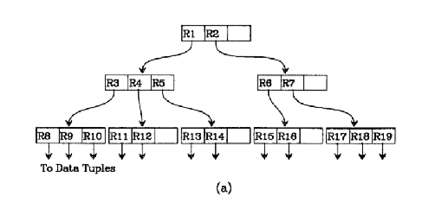
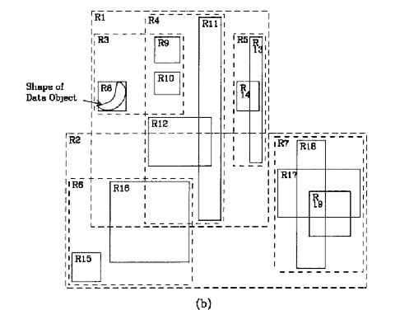
R-tree:Structure(I)
We will transverse through the R-Tree to give some idea of its structure

Slide 17
R-tree:Structure(II)
R1
We first move to the first layer of the R-tree which consist of the two nodes R1 and R2.
R2

Slide 18
R-tree:Structure(III)
R1
R4
R3
Then we move to the second layer under node R1 which consist of node R3, R4 and R5
R2
R5

Slide 19
R-tree:Structure(III)
R1
R4
R3
Then we move to the third layer under node R3 which consist of node R8, R9 and R10
R2
R5

Slide 20
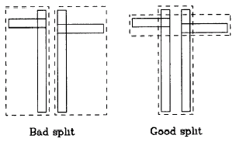
Maintenance of R-tree
Very much like the maintenance of B+ Tree. Take average O(log n) to search, insert and delete.
Concern when splitting nodes: Need to ensure that the bounding box have the smallest area

Slide 21
R-tree的典型算法
查找
插入
  选择叶子结点
  分裂结点（有多种算法）
  调整树
  必要时增加树的高度
删除
  找到包含要删除记录的叶子结点
  删除
  压缩树
  必要时减小树的高度
更新
  先删除老的记录索引，在插入新的记录索引

Slide 22
下载R-tree源代码: http://www.superliminal.com/sources/sources.htm
在该页面上找到C & C++ Code，再找到Download R-Tree Templated C++ version
注意：要装MSVC 6 SP5 或 MSVC .Net 2003
介绍R-tree的文章：R-Tree: A dynamic index structure for spatial searching， sigmod 1984

Slide 23
使用R-tree进行NN查找
Construct an index such as R-tree for the data
To prune off those MBRs(Minimum Bounding Rectangle) which can never contain a nearest neighbor.

Slide 24
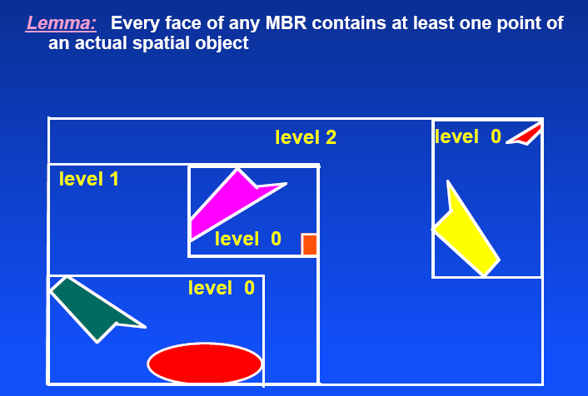
将R-tree用于NN查找

Slide 25
assuming this is the leftmost point
MBR(R)
then left border can be shifted here

Slide 26
assuming this is the leftmost point
MBR(R)

Slide 27
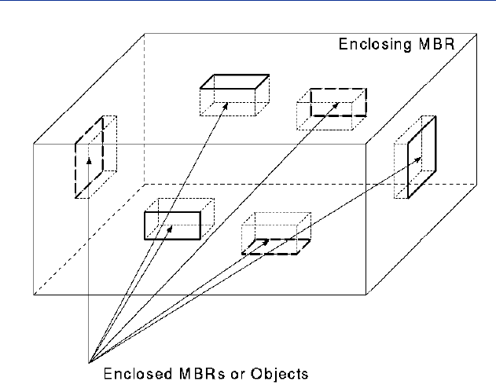
The MBR Face Property in 3-d

Slide 28
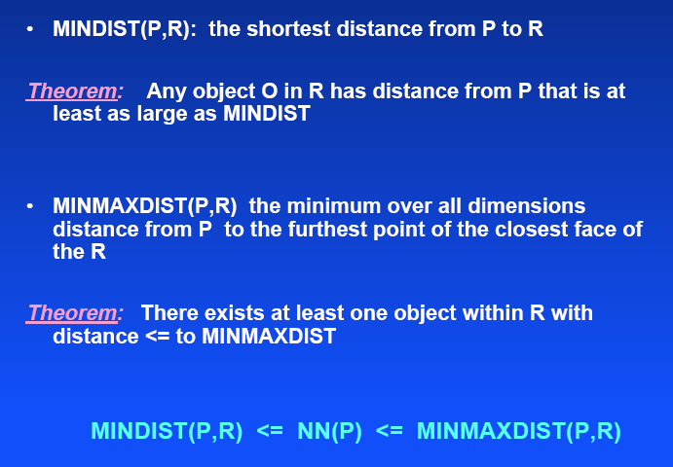
NN Metrics

Slide 29
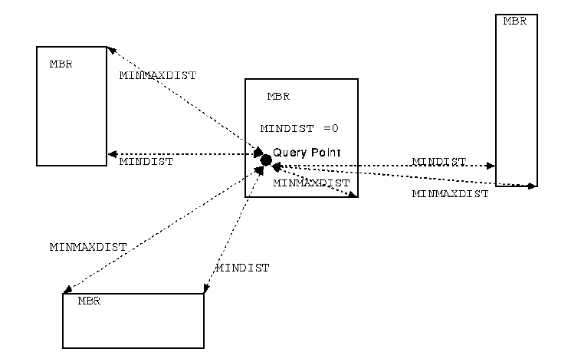

Slide 30
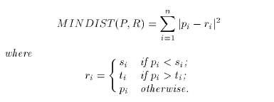
其中：s为左下角，t为右上角

Slide 31
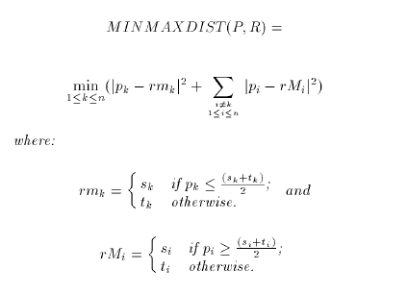

Slide 32
Pruning策略
an MBR R is discarded if there exists an R’ s.t.
  MINDIST(P,R) > MINMAXDIST(P,R’)

Slide 33
实际上，MinDist是下届，MaxMinDist是上届。
查找的过程是拿别人的下届和当前的最小上届进行比较，如果下届大于上届，则删除，否则，继续比较
尽早减小上届。提高算法性能。

Slide 34
R-tree: Finding Nearest Neighbor
First problem to be solve:
  Given a query point p and a minimum bounding rectangle (MBR), find an upper bound and lower bound for the distance r such that there exists at least one point in the MBR that is within a distance of r from p.
Why ?
  To facilitate some form of ranking to prune off uninteresting MBRs
  Eg. we can prune off MBR3 and MBR4.
p
MBR
r
distance
MBR1
MBR2
MBR3
MBR4

Slide 35
1-NN Algorithm for R-tree(II)
best first traversal of the nodes in the R-tree.
A heap is maintained for storing every MBR

Slide 36
1-NN Algorithm for R-tree(III)
The algorithm first starts from the root MBR of the R-tree and places its children MBRs into the heap
Within the heap, the MBRs are ordered based on ascending MinDist

Slide 37
1-NN Algorithm for R-tree(IV)
then repeated recursively beginning from the MBR at the top of the heap again by taking its children MBRs and inserting them into the heap.
The algorithm maintains a variable Best which is initially set to ∞and are updated later

Slide 38
Input: An R-tree R, query point p
Output: NN of p
1. Best := ∞; E={}
2. Insert the root MBR of R-tree in the heap;
3. WHILE exist MBRs in heap DO
4. Extract an MBR R in heap;
IF MinDist(R; p) > Best
THEN Exit; //Handle next R on heap
7. ELSE IF MinMaxDist(R; p) < Best
8. THEN Best = MinMaxDist(R; p);
9. IF R is not a leaf MBR THEN
10. Extract all children of R and add to heap, sort the heap;
11. ELSE add all points in R to E
12. Compute nearest dominator q among points in E;
13. Output q;

Slide 39
k-Nearest Neighbors
Definition: Given a query point p, and a distance function dist(), let q_{k} be a point in the database such that
  count( {q| dist(p,q) < dist(p,q_{k}), q ∈D} ) = k-1
The k-nearest neighbors of p are all points q such that dist(p,q) <= dist(p,q_{k})
k=10
q_{k}
p

Slide 40
R-tree: Finding k-Nearest Neighbors
First problem to be solve:
  Given a query point p and a minimum bounding rectangle (MBR), find an upper bound and lower bound for the distance r such that there exists at least one point in the MBR that is within a distance of r from p.
Why ?
  To facilitate some form of ranking to prune off uninteresting MBRs
  Eg. if k=2, we can prune off MBR4.
p
MBR
r
distance
MBR1
MBR2
MBR3
MBR4

Slide 41
k-NN Algorithm
Keep a sorted buffer of at most k current nearest neighbors
Pruning is done according to the distance of the furthest nearest neighbor in this buffer

Slide 42
k-NN分类
每个训练样本都看作n维空间中的一个点。
给定一个未知样本（类似于查询点q）， 首先找到该样本的k个近邻，将这k个近邻按照类标号进行分组，未知样本最终被分到组员最多的那个组。

Slide 43

Exercise
x
x
x
x
x
x
x
o
o
o
o
x
x
o
x
How is star classiﬁed by:
(i) 1-NN (ii) 3-NN (iii) 9-NN (iv) 15-NN (v) Rocchio?

Slide 44
本讲内容
k-NN分类
预测
分类的准确性

Slide 45
What Is Prediction?
Prediction is similar to classification
  First, construct a model
  Second, use model to predict unknown value
Major method for prediction: regression
  Linear and multiple regression
  Non-linear regression
Prediction is different from classification
  Classification refers to predict categorical class label
  Prediction models continuous-valued functions

Slide 46
有一些软件包解决回归问题。例如:
  SAS(http://www.sas.com)
  SPSS(http://www.spss.com)
  S-Plus(http://www.mathsoft.com)。

Slide 47
Linear regression
在线性回归中，数据用直线建模。是最简单的回归形式。
双变量回归将一个随机变量Y（称作响应变量）视为另一个随机变量X（称为预测变量）的线性函数。即：
Y = α + βX

Slide 48
Linear regression
在线性回归中，数据用直线建模。是最简单的回归形式。
双变量回归将一个随机变量Y（称作响应变量）视为另一个随机变量X（称为预测变量）的线性函数。即：
Y = α + βX
其中，α和β是回归系数
建模的过程主要是求回归系数，常用的方法：
  最小二乘法

Slide 49
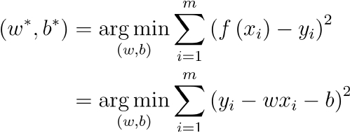
线性回归
(linear regression)
如何确定参数w和b呢？令均方误差最小化！
基于均方误差最小化来进行模型求解的方法称为“最小二乘法”，在线性回归中，最小二乘法就是试图找到一条直线，使所有样本到直线上的欧式距离之和最小

Slide 50

线性回归
(linear regression)
求解w和b使得 最小化的过程，
称为线性回归模型的最小二乘“参数估计”

Slide 51
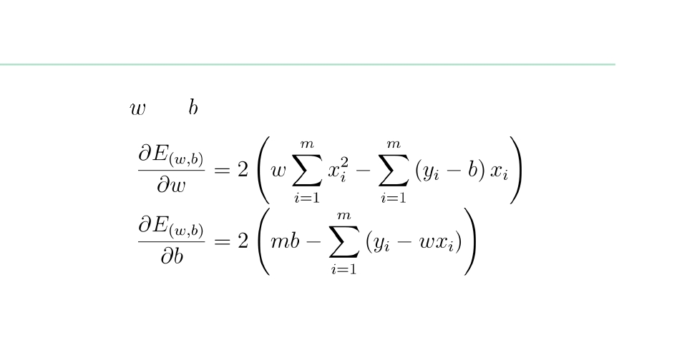


线性回归
分别对
和
求导：
令导数为 0, 得到两个方程，因为只有二个未知数，可解出

Slide 52
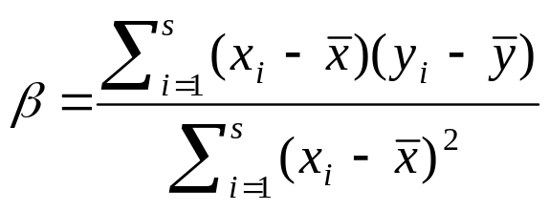
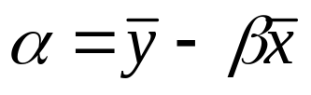


用最小二乘法求回归系数
给定s个样本或形如(x₁,y₁), (x₂,y₂),…, (x_{s},y_{s})的数据点，回归系数α和β可以用下式计算：
其中，是x₁, x₂ ,.., x_{s}的平均值，而 是y₁, y₂ ,.., y_{s}的平均值。
与其它复杂的回归方法相比，线性回归常常给出很好的近似。

Slide 53
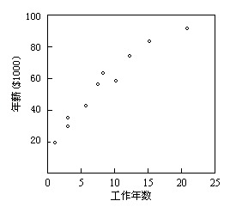
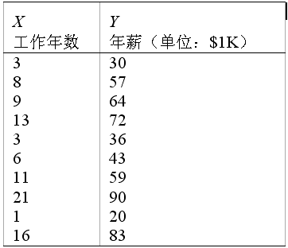
用最小二乘法求回归系数:例子

Slide 54
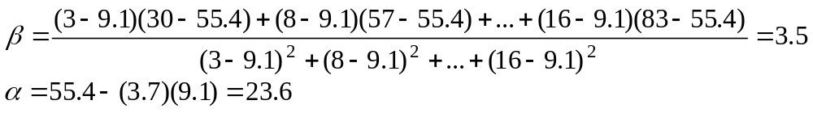
用最小二乘法求回归系数:例子
用方程Y = α + βX表示年薪和工作年数之间的关系。
给定左图数据，计算出
= 9.1， = 55.4。

Slide 55
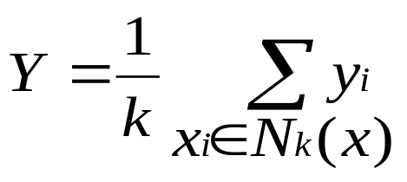
用k-NN进行线性回归
给定样本x, 根据训练集求出它的k个近邻，则：

Slide 56
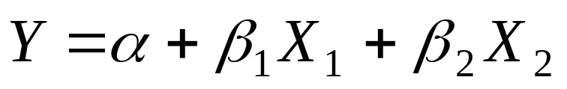
multiple regression
多元回归是线性回归的扩展，涉及多个预测变量。
响应变量Y可以是一个多维特征向量的线性函数。
基于两个预测属性或变量X1和X2的多元回归模型的例子是
最小二乘法同样可以用在这里求解α，β1和β2

Slide 57
Non-linear regression
通过在基本线性模型上添加多项式项，多项式回归可以用于建模。
通过对变量进行变换，可以将非线性模型转换成线性的，然后用最小二乘法求解。

Slide 58
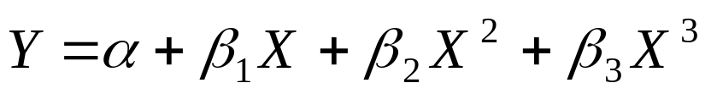

Non-linear regression
例 下面的三次多项式
通过定义如下新变量：
X₁ = X X ₂ = X ² X ₃ =X ³
可以转换成线性形式，结果为：

Slide 59
本讲内容
k-NN分类
预测
分类的准确性

Slide 60
评估分类法的准确率
保持和k-交叉确认是两种常用的评估分类法准确率的技术

Slide 61
保持法
给定数据随机地划分成两个独立的集合：训练集和测试集。通常，三分之二的数据分配到训练集，其余三分之一分配到测试集。
随机选样：是保持方法的一种变形，它将保持方法重复k次。总体准确率估计取k次迭代的平均值。

Slide 62
k-交叉确认
初试数据被划分成k个互不相交的子集S ₁ ， S ₂ ，... ， S _{k}，每个子集的大小大致相等。
训练和测试进行k次。在第i次迭代，S _{i}用作测试集，其余的子集都用于训练集。即，第一次迭代在子集S ₂,...,S _{k}上训练，而在S₁上测试；第二次迭代的分类法在子集S ₁, S ₃,...,S _{k}上训练，而在S₂上测试；如此下去。
准确率是k次迭代过程中分类结果正确的样本数除以样本总数。

Slide 63
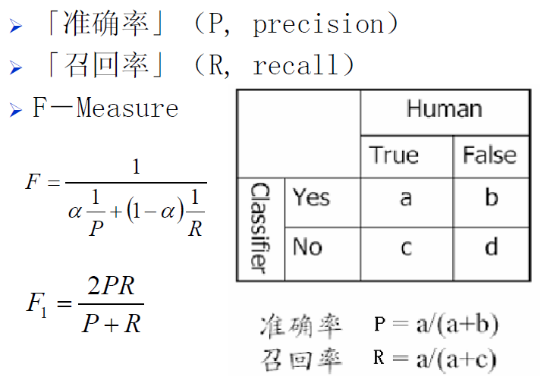
评价指标

Slide 64
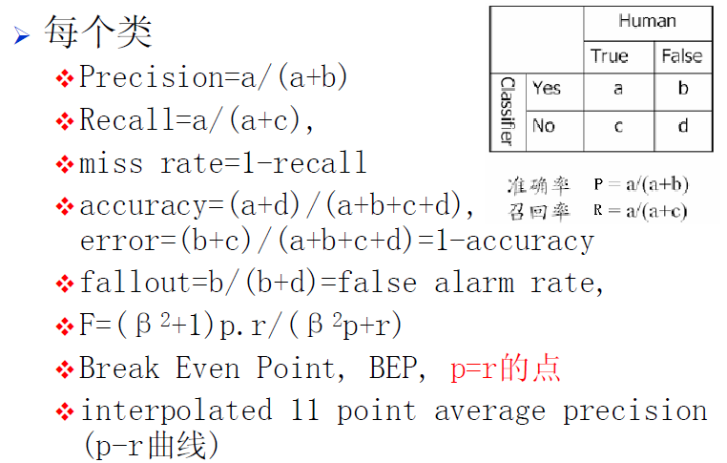
评价指标

Slide 65
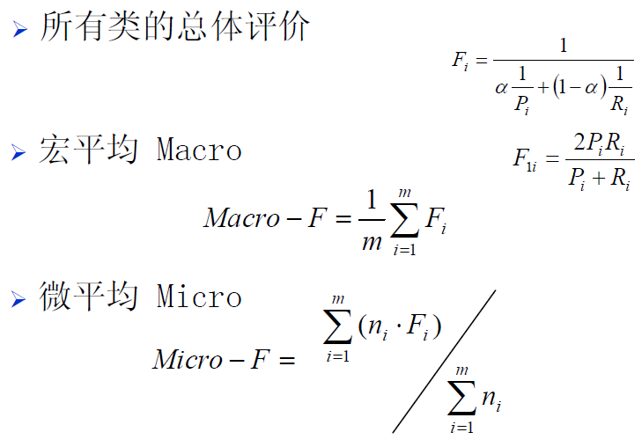
评价指标

Slide 66
总结
Classification is an extensively studied problem (mainly in statistics, machine learning & neural networks)
Classification is probably one of the most widely used data mining techniques with a lot of extensions
Scalability is still an important issue for database applications: thus combining classification with database techniques should be a promising topic
Research directions: classification of non-relational data, e.g., text, spatial, multimedia, etc..

